Slide 1
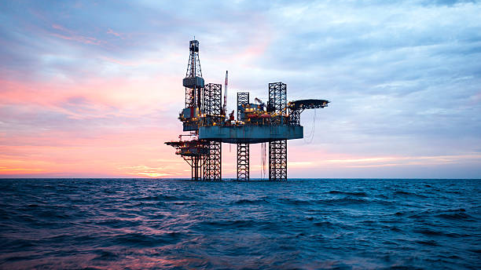
Product: Crude Oil and Natural Gas
By – Daksh Doshi, Saloni Shah, Wei Luo

Slide 2
Introduction - Crude Oil & Natural Gas
Crude oil is a liquid fuel source located underground. It is extracted through drilling. Oil is used for transportation fuels such as gasoline, diesel, and jet fuel.
West Texas Intermediate crude oil is of very high quality because it is lightweight and has low Sulphur content. For these reasons, it is often referred to as “light, sweet” crude oil. These properties make it excellent for making gasoline. That's why it is the major benchmark of crude oil in the Americas.
Brent Blend is a combination of crude oil from 15 different oil fields in the North Sea. It is less “light” and “sweet” than WTI but still excellent for making gasoline. It is refined in Northwest Europe and is the primary benchmark for crude oils in Europe or Africa.
Natural gas futures prices are based on delivery at the Henry Hub in Louisiana.
There are two primary types of natural gas marketing and trading: physical trading and financial trading. Physical natural gas marketing is the more basic type, which involves buying and selling the physical commodity. Financial trading, on the other hand, involves derivatives and sophisticated financial instruments in which the buyer and seller never take physical delivery of the natural gas.

Slide 3
Futures contract specifications – Crude Oil
Crude Oil Futures contract specs |  | E-mini Crude Oil Futures contract specs
Contract Unit | 1,000 barrels | 500 barrels
Price Quotation | U.S. dollars & cents per barrel | U.S. dollars & cents per barrel
Minimum Price Fluctuation | 0.01 per barrel = $10.00 TAS: Zero or +/- 10 ticks in the minimum tick increment of the outright | 0.025 per barrel = $12.50
Product Code | CME Globex: CL CME ClearPort: CL Clearing: CL TAS: CLT TAM: CLS | CME Globex: QM CME ClearPort: QM Clearing: QM
Settlement Method | Deliverable | Financially Settled
Delivery Procedure | Delivery shall be made free-on-board ("F.O.B.") at any pipeline or storage facility in Cushing, Oklahoma with pipeline access to Enterprise, Cushing storage | -

Slide 4
Futures contract specifications - Natural Gas
Natural Gas Futures contract specs |  | E-mini Natural Gas Futures contract specs
Contract Unit | 10,000 MMBtu | 2,500 MMBtu
Price Quotation | U.S. dollars & cents per MMBtu | U.S. dollars & cents per MMBtu
Minimum Price Fluctuation | 0.001 per MMBtu = $10.00 Inter-commodity spreads: 0.00025 per MMBtu = $2.50 TAS: Zero or +/- 10 ticks in the minimum tick increment of the outright | $0.005 per MMBtu
Product Code | CME Globex, ClearPort and Clearing: NG TAS: NGT | CME Globex and Clearing : QG
Settlement Method | Deliverable | Financially Settled
Delivery Procedure | Natural gas futures prices are based on delivery at the Henry Hub in Louisiana | Delivery shall be by cash settlement. Final settlement,following termination of trading for a contract month, will be based on the Floating Price. The final settlement price will be the Floating Price calculated for each contract month.

Slide 5
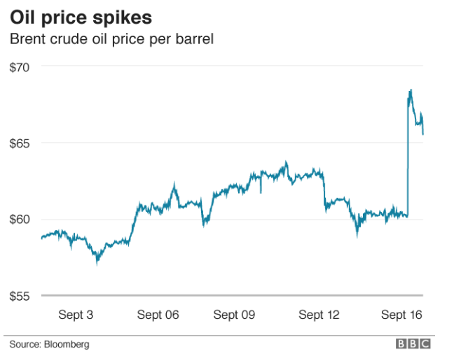
Recent events affecting the price of energy
Saudi Aramco reveals attack damage at oil production plants
Twenty-five drones and missiles were used in the attack that forced the kingdom to shut down half of its oil production, Saudi Arabia has said.
Two sites were hit — the Abqaiq and Khurais oil facilities — which took out 5.7 million barrels per day of crude.
Together they account for about 50% of Saudi Arabia's oil output, or 5% of daily global oil production

Slide 6
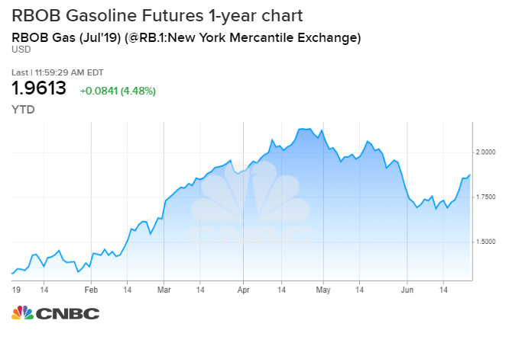
Philadelphia fire affects gas prices
Shutdown of fire-gutted massive Philadelphia refinery pushes gas prices higher, costs 1,000 jobs.
The refinery was the largest and oldest on the East Coast and accounts for about 27% of that region’s refining capacity

Slide 7
Breakdown in the Saudi-Arabia-Russia oil alliance would mean to the market
Saudi Arabia and Russia have so far failed to reach an agreement to cut oil production even with the COVID-19 epidemic in China expected to significantly hurt energy demand this year, putting the more than three-year-old alliance between the two major oil producers at risk.
Saudi Arabia is weighing a break in its alliance with Russia, The Wall Street Journal reported Friday, citing people familiar with the matter. The Saudis are holding talks with Kuwait and the United Arab Emirates this week to discuss a possible joint production cut of as much as 300,000 barrels a day, the report said.
“If the alliance were to split, the immediate reaction would be a drop in oil prices, but that could be reversed by a strong OPEC cut,” said James Williams, energy economist at WTRG Economics. “I doubt that OPEC is anywhere near a breakup, but the alliance between OPEC and non-OPEC producers is fragile.
Oil Prices Slip as Coronavirus Spread Dashes Hopes of a Demand Rebound
Oil prices slipped 1.5% on 21st February, 2020, as fears over the spread of the coronavirus outside of China mounted and economic data began to show the extent of the epidemic’s impact.
Brent crude was down 1.4%, at $58.46 a barrel, while U.S. crude dropped 0.9%, at $53.38 a barrel.

Slide 8
What Affects prices of Crude Oil?

Slide 9
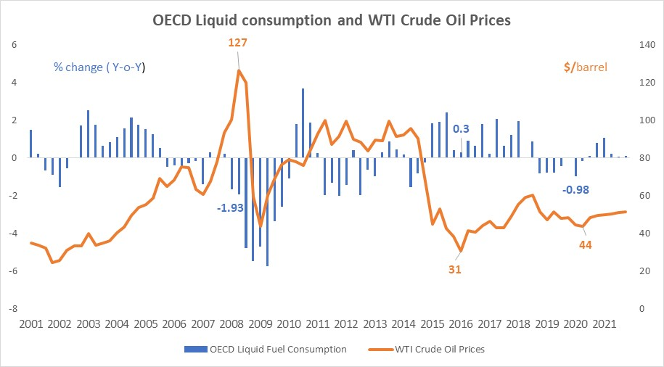
Demand : OECD Countries
The Organization of Economic Cooperation and Development (OECD) consists of the United States, much of Europe, and other advanced countries.
Contributes to 53% of total oil consumption.
Oil consumption in OECD countries fell the most during period of economic downturn.

Slide 10
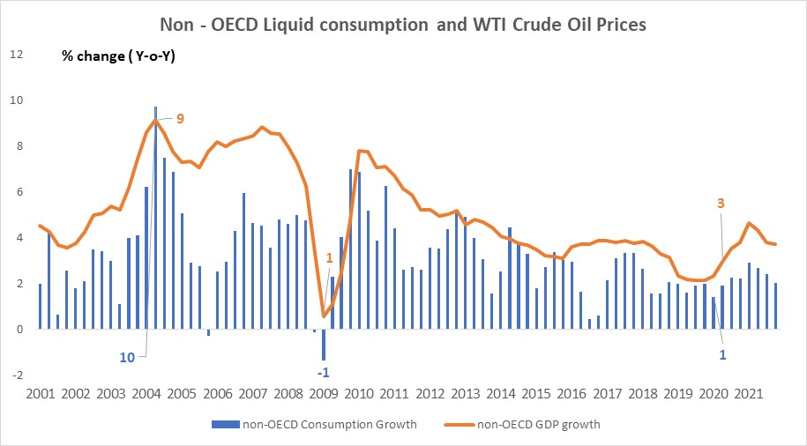
Demand : Non OECD Countries
Strong relationship between GDP growth rates & growth in oil consumption.
Since 2001, oil consumption declined only 3 times.
Increased demand due to economic growth offsets downward pressure on oil consumption due to higher oil prices.

Slide 11
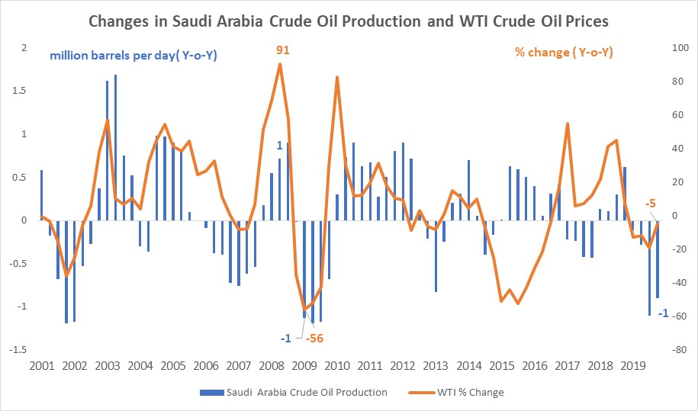
Supply : OPEC Countries
OPEC member countries produce about 40 percent of the world's crude oil and represents about 60 percent of the total oil exports.
OPEC controls oil prices through its pricing over volume strategy.
For example, when there is a glut of oil in the world, OPEC cuts back on its production and when there is less oil, it increases oil prices to maintain stable levels of production.
Notes:
Organization of petroleum exporting countries. An intergovernmental organization whose stated objective is to "coordinate and unify the petroleum policies of member countries." It was created at the Baghdad Conference on September 10-14, 1960. Member countries ;- Saudi arabia, Iran, Iraq, Indonesia

Slide 12
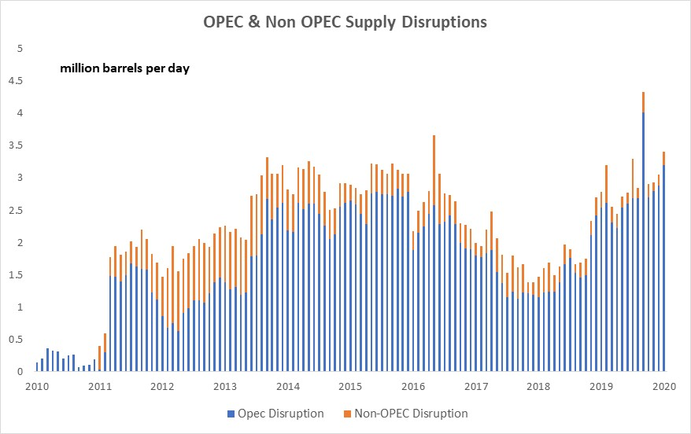
Supply : OPEC and Non OPEC countries.
The extent to which OPEC member countries utilize their available production capacity is often used as an indicator of the tightness of global oil markets, as well as an indicator of the extent to which OPEC is exerting upward influence on prices.
This chart shows EIA's monthly estimates of unplanned, global supply outages. Estimated unplanned disruptions reflect the level of volumes shut-in, accounting for effective production capacity.

Slide 13
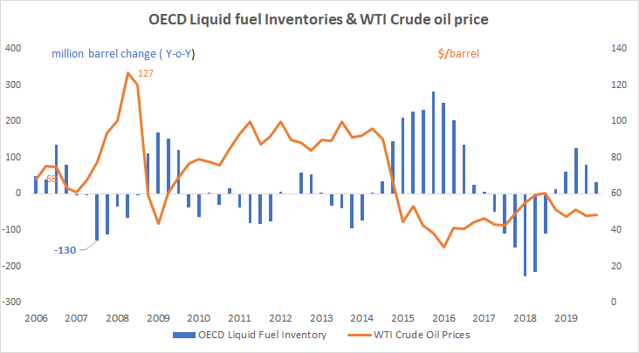
Inventory
During periods when production exceeds consumption, crude oil and petroleum products can be stored for expected future use.
In the economic downturn of late 2008 and early 2009, the unexpected drop in world demand led to record crude oil inventories in the United States and other OECD countries.
In contrast, when consumption outstrips current production, supplies can be supplemented by draws on inventories to satisfy the needs of consumers.

Slide 14
Natural gas
Trader either on an exchange or over-the-counter (private)
Henry Hub natural gas (future contract)
One of the six primary futures contracts
Traded on the New York Mercantile Exchange (NYMEX)
Over-the-counter contract
A typical one is for the delivery of a specified amount of natural gas at a roughly uniform rate over 1-month period

Slide 15
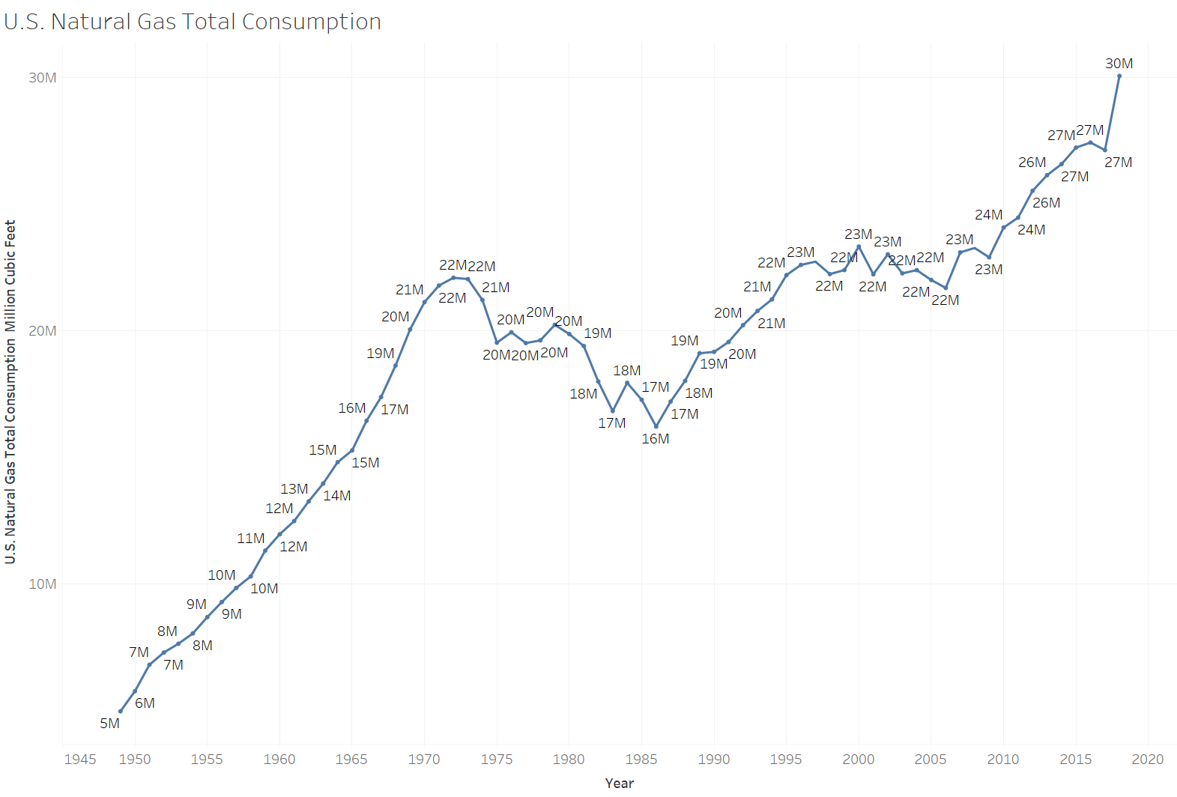
Demand
Went through a period of deregulation and the elimination of government monopolies in the 1980s and 1990s .
Nowadays the supplier is not necessarily the same company as the producer
Suppliers are faced with the problems of meeting daily demand
A popular source for heating house and used to produce electricity (AC)
Demand is seasonal and dependent on the weather

Slide 16
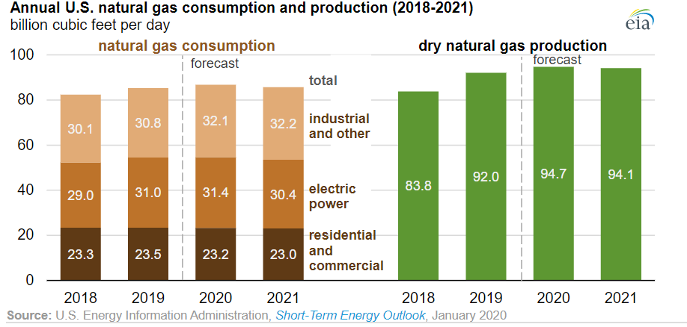

Slide 17
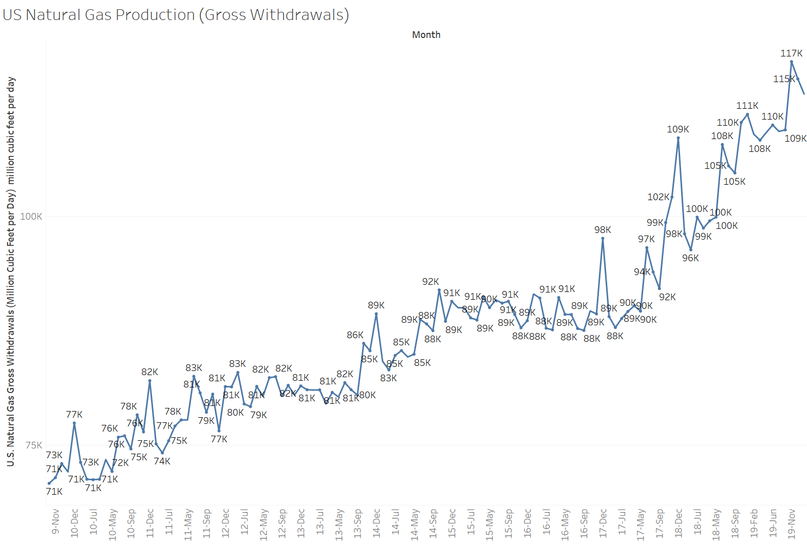
Supply
Natural Gas Liquidation
Improved drilling efficiency and cost reductions
Higher associated gas production from oil-directed rigs
Increased takeaway pipeline capacity from the Appalachian and Permian production regions

Slide 18
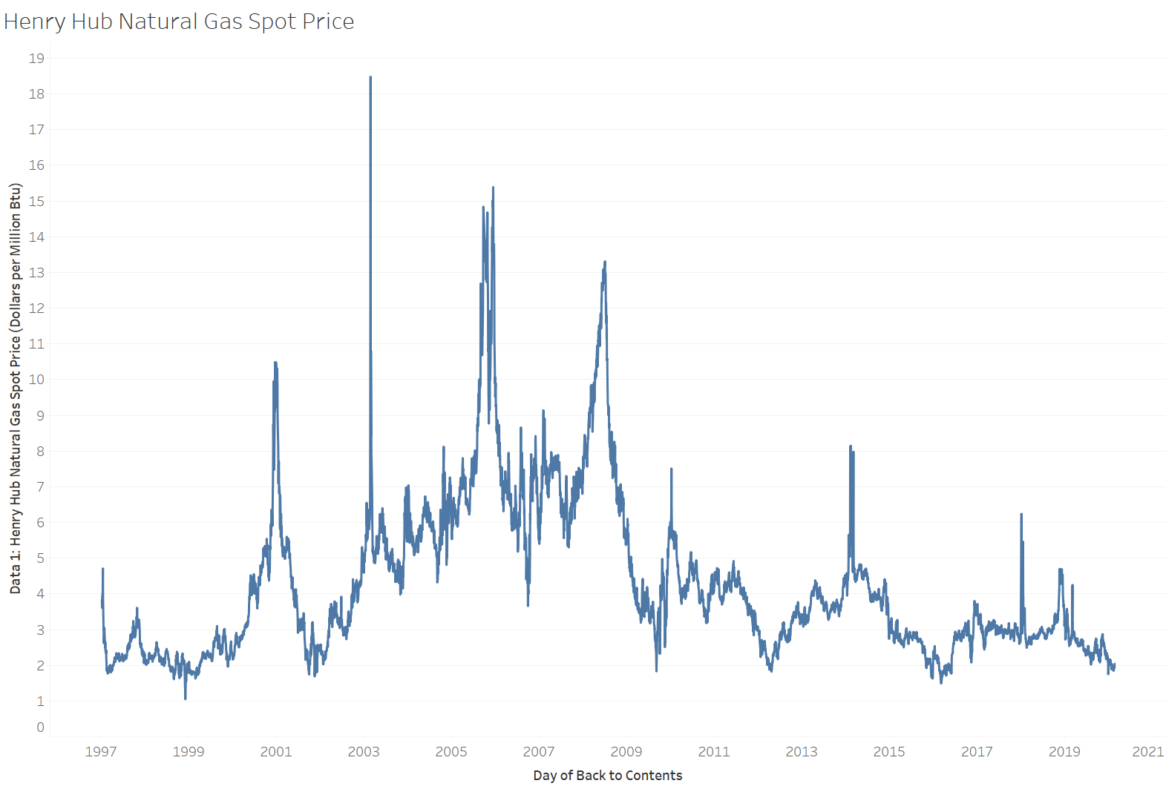
Natural Gas Chart

Slide 19
References:
Oil prices soar after attacks on Saudi facilities https://www.bbc.com/news/business-49710820
Shutdown of fire-gutted massive Philadelphia refinery pushes gas prices higher, costs 1,000 jobs https://www.usatoday.com/story/news/nation/2019/06/27/philadelphia-oil-refinery-fire-closure-could-drive-up-gasoline-prices/1581532001/
What Drives Crude Oil Prices? https://www.eia.gov/finance/markets/crudeoil/financial_markets.php
U.S. Energy Information Administration https://www.eia.gov/
Options Futures and Other Derivatives 10th Edition by John C. Hull

Slide 20
Thank You

